Slide 1

Data Science BootCamp 1 by Deep Learning Tech
Project 1 Summary: Ecommerce Dataset
Saad Iqbal
email: siqbal_a@hotmail.com

Slide 2
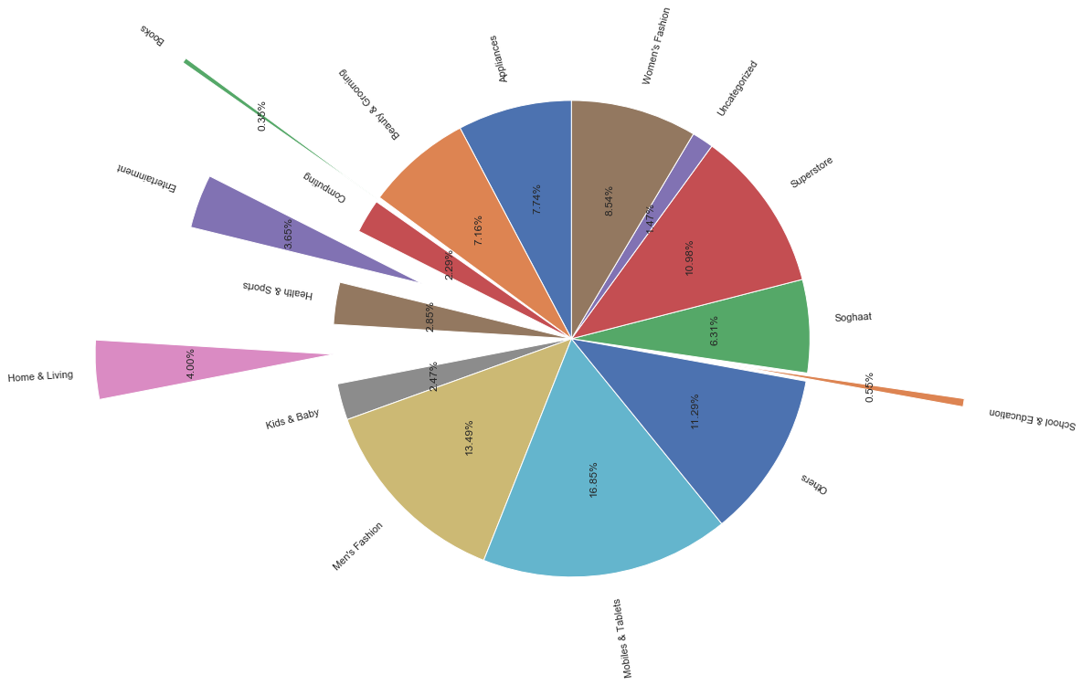
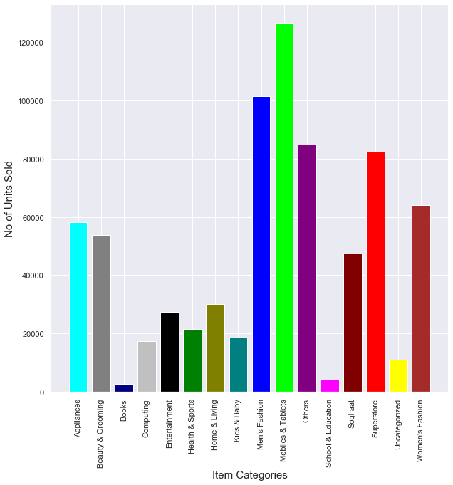
Top Selling Item Categories

Slide 3
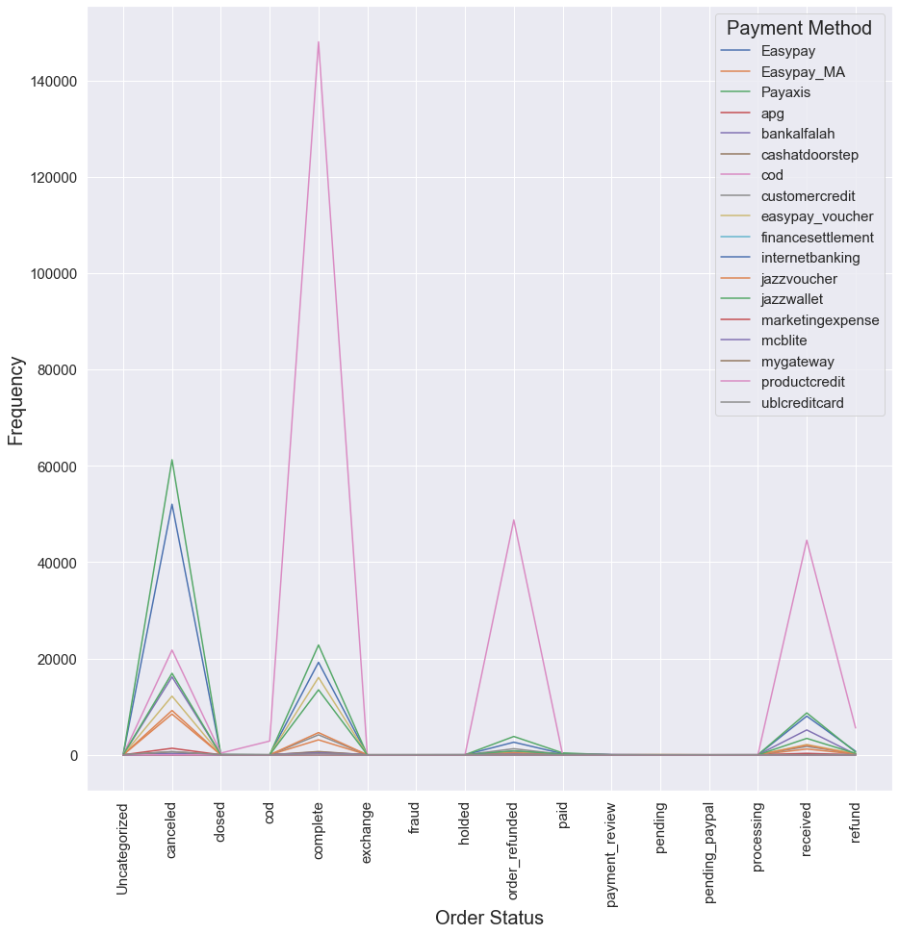
Correlation b/w Order & Payment Method
1- Positive Correlation between Orders Completion and Payment Methods based on Credit such as Cash on Delivery, Credit Cards and Discount Vouchers
2- Negative Correlation between Orders Completion and Advance Payment Methods such as Internet Banking, Mobile Banking etc

Slide 4
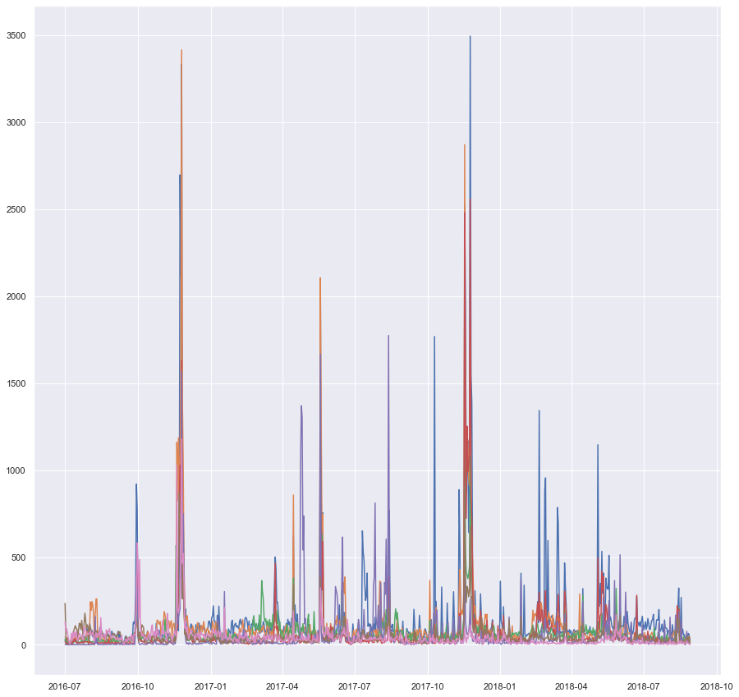
correlation B/W order date & item category
Plotted top 5 item categories graphs against the order dates.
Correlation between order date and item category seems to be positive due to high peaks i.e. annual product sale at the end of the year supported by mid year high selling season.

Slide 5
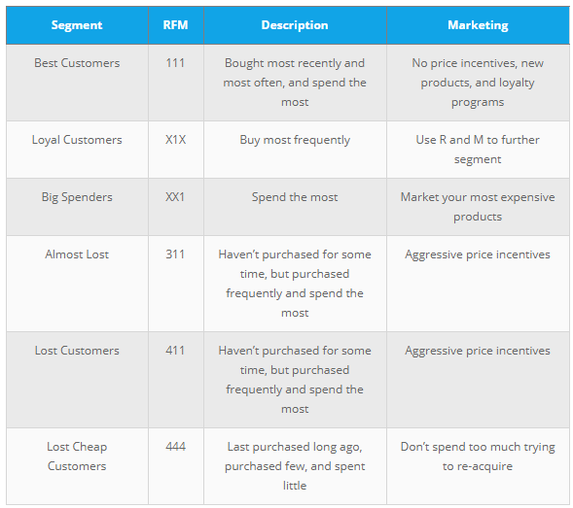
Customer Liftime Value: RFM Score
RECENCY (R): Days since last purchase
FREQUENCY (F): Total number of purchases
MONETARY VALUE (M): Total money this customer spent

Slide 6
Top 10 best customers!

Slide 7
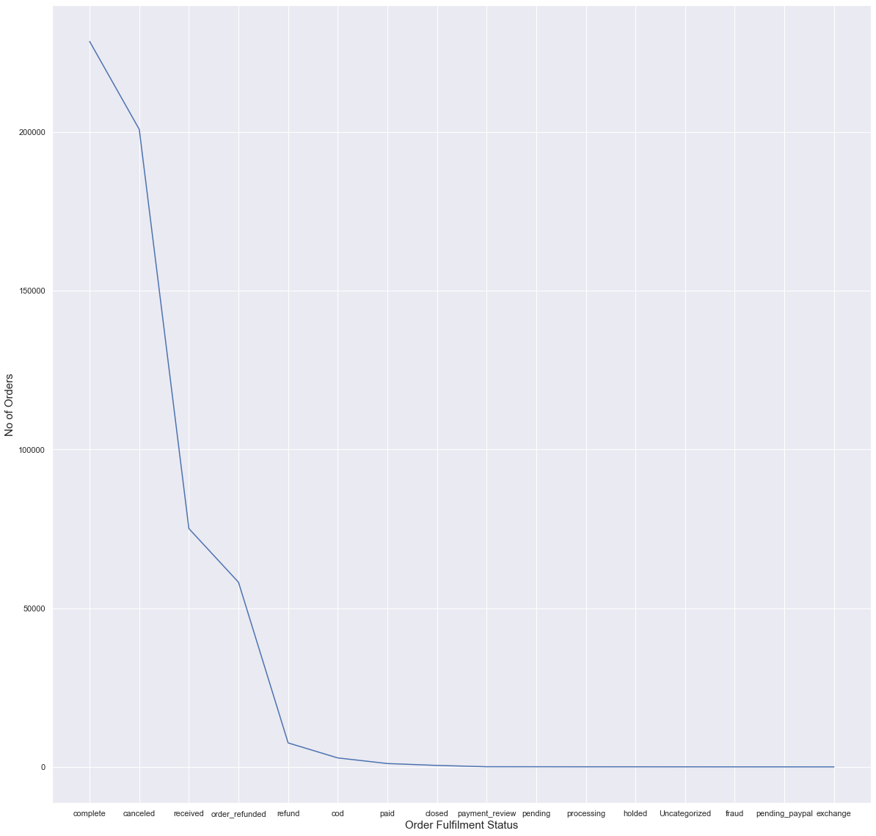
Order Fulfilment Status

Slide 8
Thank You!

